Slide 1


Mini Project
E-Learning Website
Submitted By-
Krishna Saxena (2115000552)
Samiksha (2115000903)
Saniya Gupta (2115000909)
Submitted to-
Ms. Ruchi Gupta
Senior Trainer

Slide 2

Creating Engaging E-Learning Websites
Welcome to the world of e-learning! Discover the benefits of online education, the technologies for front-end development, and design considerations.

Slide 3
Benefits of E-Learning Websites
1
Flexible Learning
2
Cost-Effective
Access courses anytime, anywhere, fitting into busy schedules.
No travel expenses or physical learning materials to worry about.
3
Interactive Experience
4
Self-Paced Learning
Easily engage with multimedia content like videos and interactive quizzes.
Learn at your own speed and revisit materials as needed.

Slide 4
Front-end Technologies used for E- Learning
HTML
CSS
JavaScript
HTML is the backbone of web content, providing a structured markup language that defines the elements and layout of a webpage. In e-learning, it's crucial for organizing and presenting text, images, and multimedia elements.
CSS complements HTML by controlling the visual presentation of a webpage. In e-learning, CSS is used to style the content, ensuring a consistent and aesthetically pleasing design, including fonts, colors, spacing, and responsive layouts.
JavaScript adds interactivity and dynamic behavior to web pages. In e-learning, it's employed for creating engaging user interfaces, implementing interactive quizzes, managing multimedia elements, and facilitating real-time interactions without requiring page reloads

Slide 5
Design Considerations for E-Learning Websites
Responsive Design
Intuitive Navigation
Ensure a consistent experience across devices and screen sizes.
Make it easy for learners to find their way around the platform.
Accessible Content
Branding and Visuals
Consider different learning needs and enable assistive technologies.
Create a visually appealing and cohesive learning environment.

Slide 6

User Experience Best Practices
1
Clear Instructions
We provide concise and actionable guidance for each learning activity.
2
Intuitive Navigation
Ensured a user-friendly navigation system that is intuitive and easy to understand.
3
Responsive Support
Offer prompt assistance through forums, live chats, and dedicated support staff.

Slide 7
Integration of Front-End for E-Learning
Course Listings
Responsive Design Implementation
Performance Optimization
Interactive Learning Modules

Slide 8
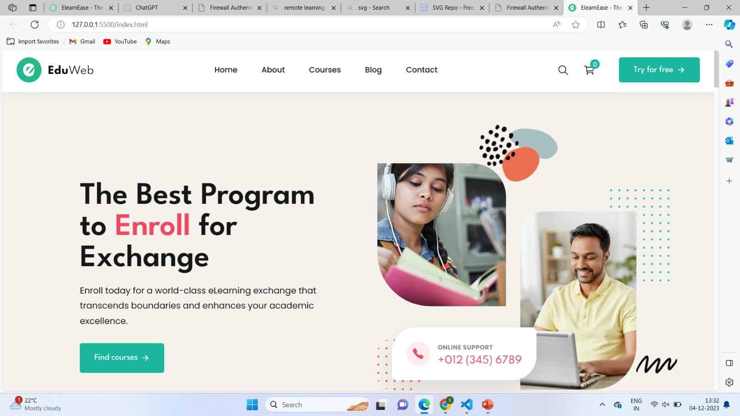

Slide 9
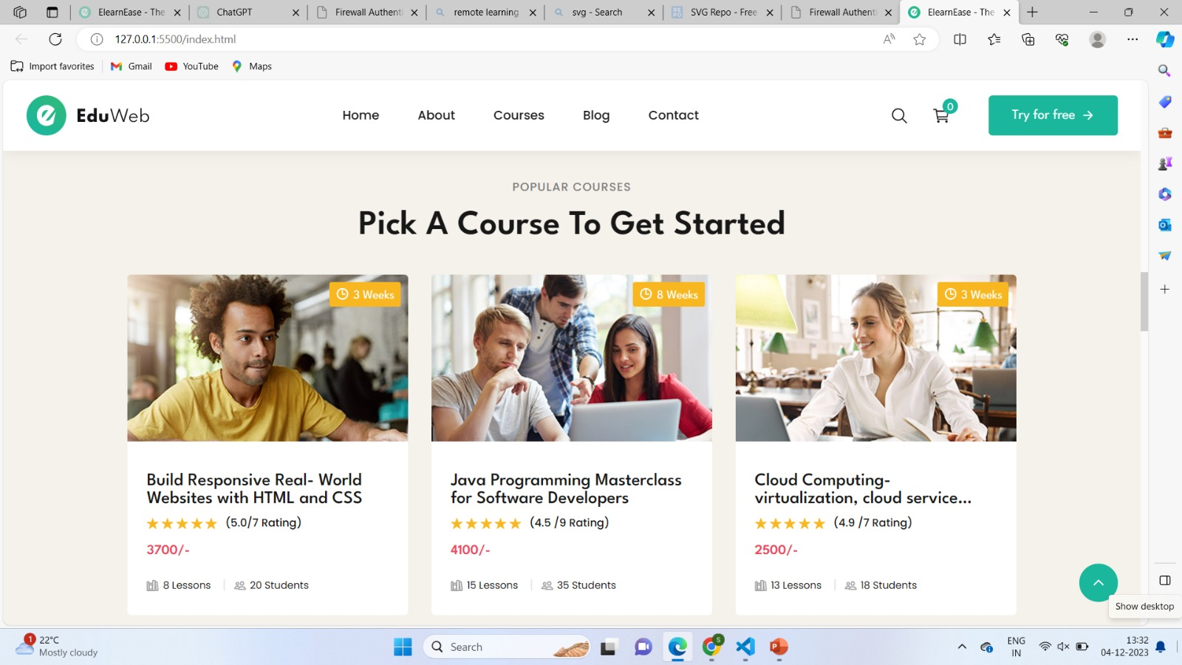

Slide 10
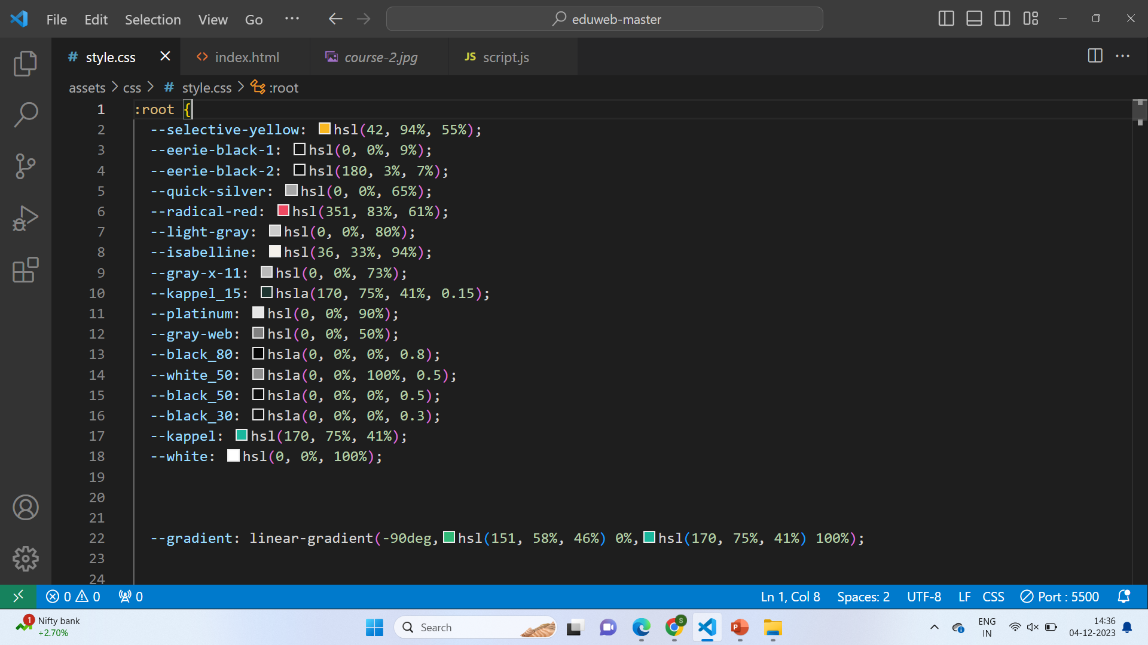
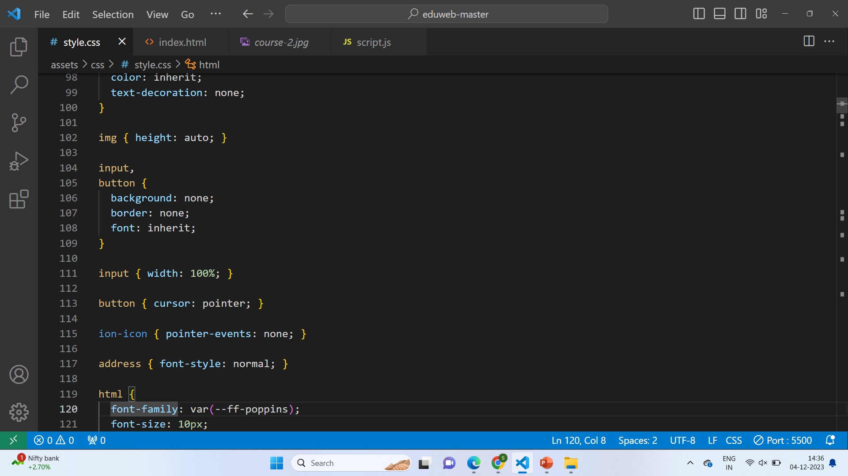
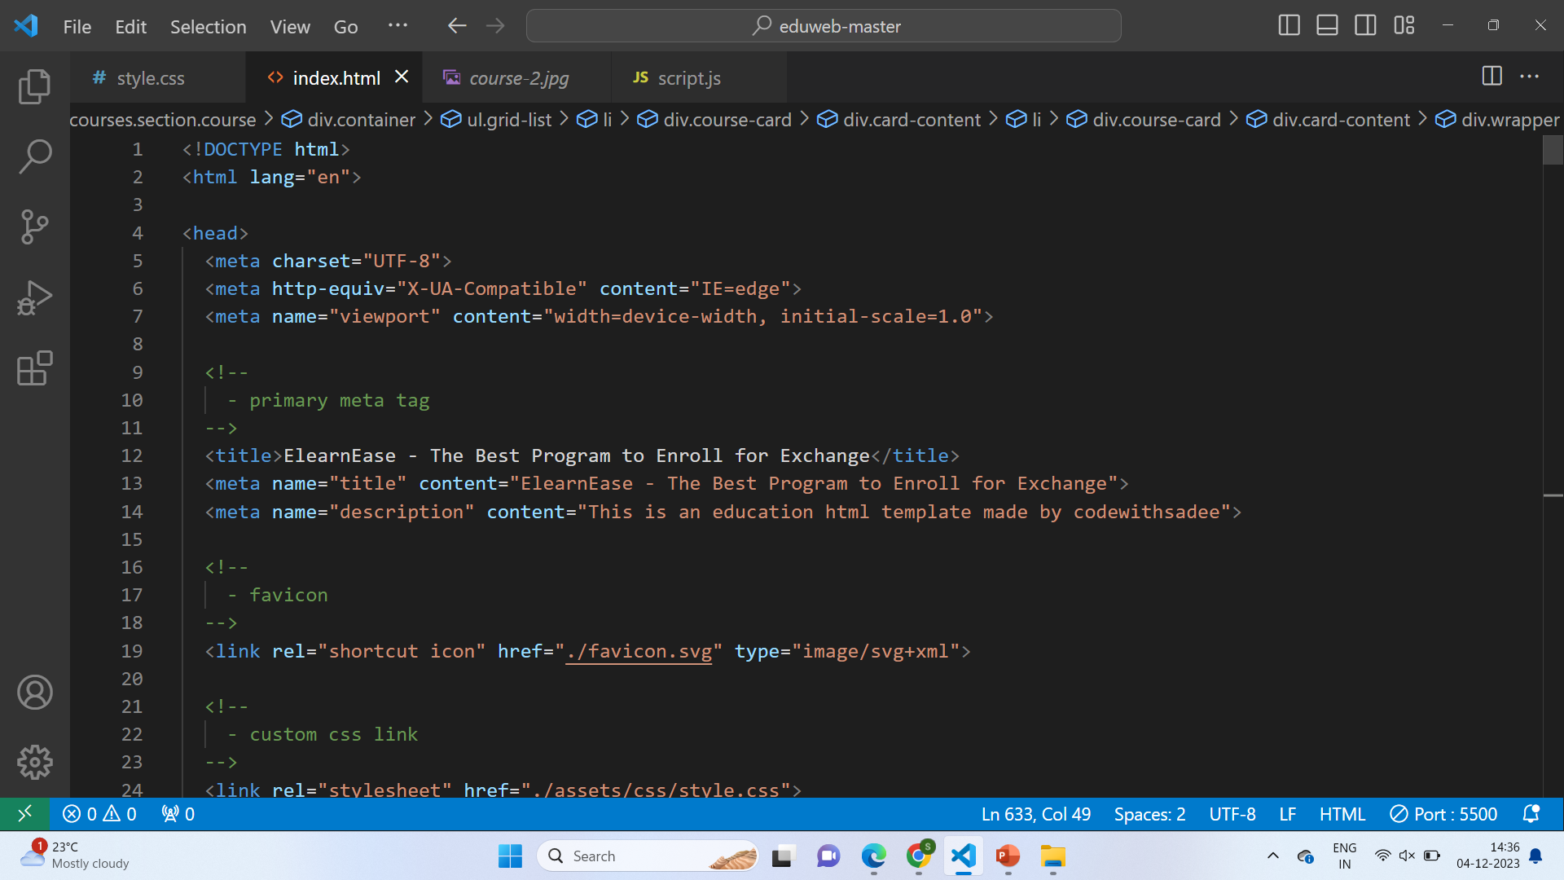

Slide 11
Conclusion
1
Empowering Learning
E-Learning brings education to the fingertips of millions, enabling lifelong learning.
2
Innovative Technology
Continued advancements will drive more engaging and interactive e-learning experiences.
3
Endless Possibilities
Explore new front-end tools and strategies to shape the future of e-learning.

Slide 12
Future Developments
Virtual Reality (VR)
Artificial Intelligence (AI)
Immerse learners in virtual environments for unparalleled engagement.
Personalize learning content and deliver tailored experiences.
Mobile Learning
Adaptive Learning
Further optimize e-learning experiences for mobile devices and on-the-go learning.
Customize learning paths based on individual learner progress and needs.

